Slide 1
5LTE0 – Module 3: Quantum Secure Cryptography
2024-02-27 & 2024-02-29
Sebastian Verschoor (s.r.verschoor@tue.nl)
Electro-Optical Communication Systems (ECO) group

Slide 2
Hidden slides
This slide deck contains hidden slides and notes, which are for background reading only and are not part of the exam material.

Slide 3
Goals for this module
How does cryptography used today work?
How do quantum computers pose a threat to (online) security?
How can quantum communication provide security?
Notes:
Content: security protocols, symmetric and asymmetric encryption, quantum threat and consequences, classic and quantum cyber-attacks, post-quantum cryptography, key exchange protocols (classic and QKD based), man-in-the-middle, BB84, key distillation, QBER

Slide 4
Outline
Cryptography
Symmetric cryptography
Asymmetric cryptography
Protocols
Quantum threat
Problem
Solutions
Quantum key distribution
BB84
Information reconciliation
Privacy amplification
The authenticated channel
Comparing to non-quantum cryptography
Notes:
Goal is to get an overview of the various components of QKD, to understand the context in which QKD operates.
A non-goal is for the student to master all subjects in depth, after all this is a course on quantum communication, not on (quantum) cryptography.

Slide 5
Cryptography – the basics
Alice and Bob want to communicate
Mallory (who is malicious) is actively interfering with them
(in some weaker models Eve is only passively eavesdropping)
Eve is actively interfering with them
Kerckhoff’s principle
aka Shannon’s Maxim: “the enemy knows the system”
but the enemy does not know the keys
Mallory Eve carries the messages (Dolev-Yao model)
she can inspect, change, re-order, replay, drop, inject any message
may (sometimes) compromise some participants
usually this represents “hacking” their computers
Notes:
Kerchhoff’s principle: Il faut qu’il n’exige pas le secret, et qu’il puisse sans inconvénient tomber entre les mains de l’ennemi

Slide 6
Outline
Cryptography
Symmetric cryptography
Asymmetric cryptography
Protocols
Quantum threat
Problem
Solutions
Quantum key distribution
BB84
Information reconciliation
Privacy amplification
The authenticated channel
Comparing to non-quantum cryptography
Notes:
Goal is to get an overview of the various components of QKD, to understand the context in which QKD operates.
A non-goal is for the student to master all subjects in depth, after all this is a course on quantum communication, not on (quantum) cryptography.

Slide 7
Confidentiality
Alice and Bob want their message to remain secret
“Hello Bob!”
“Hello Bob!”
“Hello Bob!”

Slide 8
Encryption
Symmetric encryption: Alice and Bob need to share a secret key
examples: AES, ChaCha20, one-time pad
?
Encrypt
<+EV:2F!J+*.@)*K0@#6
Decrypt
“Hello Bob!”
“Hello Bob!”

Slide 9
Encryption
Encryption provides confidentiality (or secrecy) of messages
Encryption can be probabilistic
Correctness: decryption must always decrypt to the right plaintext*
Symmetric: Alice and Bob share the same key $k$
Informal security definition: $c$ should reveal no information about $m$
Formal security definition covered in the tutorial
Definition: cipher
Given a shared key $k$, for any plaintext message $m$, Alice encrypts as $$c\underset{←}{\$}{\text{Enc}}_{k}(m)$$ and Bob decrypts the ciphertext $c$ as $$m←{\text{Dec}}_{k}(c)$$
Notes:
*) Some ciphers have a $δ$-correctness requirement, meaning that decryption might fail with some probability $δ$. Typically, $δ$ must be negligibly small for security to hold.

Slide 10
Encryption (example)
The key $k$ must be discarded
Reusing the key leaks information about the plaintexts:
$$c_{0}⊕c_{1}=\left({k⊕m}_{0}\right)⊕\left(k⊕m_{1}\right)=m_{0}⊕m_{1}$$
The OTP requires a key as long as the message
In practice we use AES (or something similar):
with a short (128-bit or 256-bit) key you can encrypt many/long messages
Example: one-time pad (OTP)
Given the message bits $m$ and key bits $k$, Alice encrypts the bits as $$c←k⊕m$$ where $⊕$ is bitwise addition modulo two, aka exclusive-or (XOR). Decryption is the same for Bob: $$m←k⊕c$$
Notes:
Search term: crib dragging, if you’re interested in how to recover $m_{0}$ and $m_{1}$

Slide 11
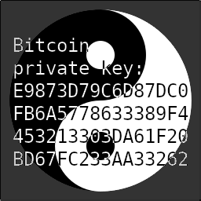
Two-time pad is insecure
$$⊕$$
$$=$$
$$=$$
$$⊕$$
$$⊕$$
$$=$$
$$=$$
$$m_{1}⊕k=c_{1}$$
$$m_{2}⊕k=c_{2}$$
$$c_{1}⊕c_{2}=m_{1}⊕m_{2}$$

Slide 12
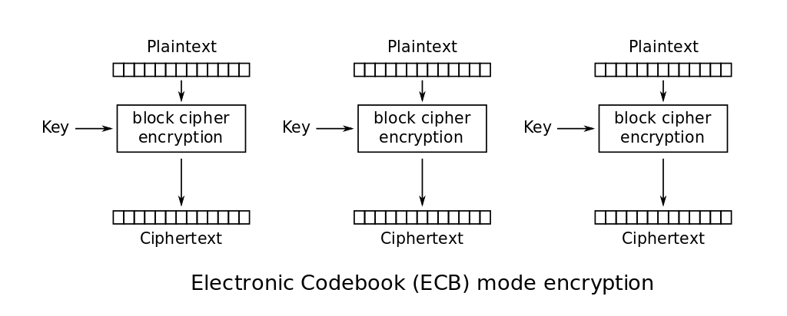
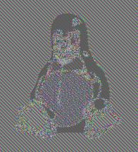
Block modes
AES operates on 128-bit blocks
We want to encrypt longer messages.
Let’s try the most straightforward approach:
this is insecure

Slide 13
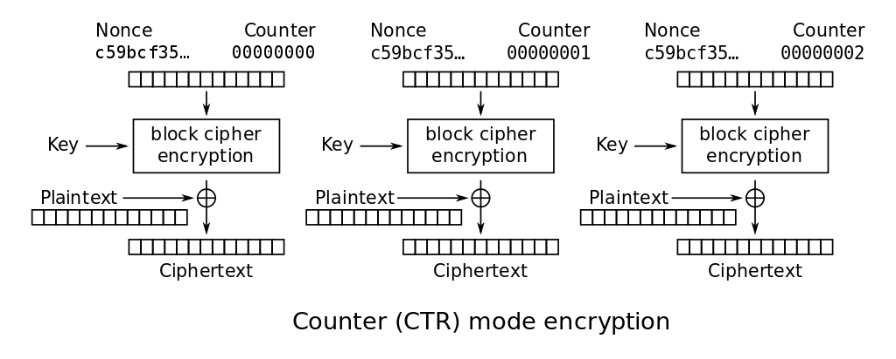
Block modes
Requires a nonce (number used once)
also called an initialization vector (IV)
must be unique per key
no padding required

Slide 14
Confidentiality (computational)
The ciphertext “gives no information” about the plaintext
$n$-bit security: Eve expects to try $2^{n}$ keys before finding the right one
<+EV:2F!J+*.@)*K0@#6
Decrypt
DJsE6ASuR#+EV1>F8
<+EV:2F!J+*.@)*K0@#6
Decrypt
B45gi@:s-oDfp/@F`[
$⋮$ repeat $\sim 2^{n}$ times
<+EV:2F!J+*.@)*K0@#6
Decrypt
“Hello Bob!”

Slide 15
Security of encryption (computationally)
We must formalize “reveal no information”
Passive security
Security against an eavesdropper (Eve), who observes many ciphertexts
Game-based definition
INDistinguishability under Chosen Plaintext Attacks (IND-CPA)
Challenger secretly selects a random bit $b$ and key $k$
Adversary sends many* messages pairs $(m_{0},m_{1})$
Challenger replies with $c_{b}← {\text{Enc}}_{k}(m_{b})$
Enc is secure if the adversary cannot guess $b$ with probability $>\frac{1}{2} + ε$
$ε$ is the security parameter
Active security
Security against a malicious adversary (Mallory), who tampers with communication
INDistinguishability under Chosen Ciphertext Attacks (IND-CCA)
Same as IND-CPA, but adversary may also request many decryptions

Slide 16
Confidentiality (information theoretical)
Perfect security
Eve has no way of distinguishing correct decryptions from incorrect ones
Statistical security
Eve has only a negligible probability of guessing the correct decryption
Importantly, both definitions are independent of the adversary’s computing power
<+EV:2F!J+*.@)*K0@#6
Decrypt
“Hi Mallory”
<+EV:2F!J+*.@)*K0@#6
Decrypt
“Hello Bob!”

Slide 17
Negligibility
In cryptography we care about “negligibility in the security parameter”
(the security parameter is often the key-length in symmetric cryptography, but not in asymmetric cryptograph)
Definition: negligible
A function $μ :ℕ→ℝ^{+}$ is negligible in $λ$ if for every polynomial $p$ there exists a $λ_{0}$ such that for all $λ>λ_{0}$: $$μ\left(λ\right)<\frac{1}{p(λ)}$$

Slide 18
Integrity and authentication
Integrity: nobody should be able to change the message
Authentication: Bob knows the message came from Alice
“I love you, Bob!”
“I hate you, Bob!”

Slide 19
Message Authentication Code (MAC)
Symmetric: Alice and Bob share a secret key
Compute a tag on the message
allows Bob to detect any changes
“I love you, Bob!”
MAC
?
“I love you, Bob!”
MAC
EQ?
“I love you, Bob!”

Slide 20
Message Authentication Code (MAC)
Symmetric: Alice and Bob share a secret key
Compute a tag on the message
allows Bob to detect any changes
“I love you, Bob!”
MAC
“I hate you, Bob!”
MAC
EQ?
“I hate you, Bob!”

Slide 21
Message integrity
We require integrity of messages: the adversary cannot change it (undetected)
Security (informal): Eve cannot create a valid $t$ for any $m$
Note that authentication is implicit
Bob assumes that only Alice knows $k$
Definition: Message Authentication Codes (MAC)
Given a shared key $k$, for any message $m$, Alice computes the MAC tag $$t ← {\text{MAC}}_{k}(m)$$ and sends $(m, t)$. Bob, upon receiving $(m^{′}, t^{′})$, verifies by checking $$t^{′}={\text{MAC}}_{k}\left(m^{′}\right)$$ and rejects the message if $t≠t^{′}$.
Notes:
MACs only give message authentication: protocols still need to protect against attacks such as message replays, message reordering, etc.

Slide 22
Poly1305
The key $s$ acts as a one-time pad and must be discarded after use
Secure only if AES is secure, but the key can be reused
Example: Poly1305 (simplified)
Given key $(r,s)$: split the message $m$ in 128-bit blocks $m_{1}, m_{2}, …, m_{n}$ evaluate the polynomial $y←m_{1}r+m_{2}r^{2}+…+m_{n}r^{n} \text{mod} 2^{130}−5$ encrypt to get the tag: $t←y+s \text{mod} 2^{128}$
Example: Poly1305-AES
Given key $(r,s)$ and nonce $n$: compute $y$ as above encrypt to get the tag: $t←y+{\text{AES}}_{s}\left(n\right) \text{mod} 2^{128}$
nonce: a number used once
Notes:
The real Poly1305 also applies padding to avoid problems with all-zero messages

Slide 23
Unforgeability (computational)
Eve cannot forge tags for any (other) message
$n$-bit security: Eve can locally try to find the correct key among $2^{n}$ keys
“I love you, Bob!”
MAC
“I love you, Bob!”
MAC
?
“I love you, Bob!”
MAC
?
$⋮$ try $\sim 2^{n}$ keys
“I love you, Bob!”
MAC
“I hate you, Bob!”
MAC
“I hate you, Bob!”
MAC
EQ?
Notes:
This is somewhat simplified: collisions (under different keys) occur in the tags, so that many keys will result in the correct tag.
However, with just a few (message, tag)-pairs, Eve should be able to find a unique key that generated all those tags.

Slide 24
Security of authentication
Existential UnForgeability under Chosen Message Attack (EUF-CMA)
Challenger generates $k$
Adversary sends many messages $m$
Challenger replies with $t←{\text{MAC}}_{k}\left(m\right)$
Adversary outputs $\left(m^{′}, t^{′}\right)$
Adversary wins if $m′$ was not sent in step 2 and ${\text{MAC}}_{k}\left(m^{′}\right)=t′$
The security parameter $ε$ is the probability that the adversary wins this game
Strong EUF-CMA (sEUF-CMA)
EUF-CMA game, but $m′$ may have been sent in step 2 (but the reply in step 3 was not $t′$)
If MAC is deterministic, then EUF-CMA $≡$ sEUF-CMA

Slide 25
Authentication (information theoretical)
Eve cannot verify forgeries locally
n-bit statistical security: each forgery succeeds with probability $2^{−n}$
Requires discarding the authentication key (or at least some part of it)
“I hate you, Bob!”
MAC
“I hate you, Bob!”
MAC

Slide 26
Authenticated Encryption
Combined encryption and authentication
required for confidentiality against active attackers!
“Hello Bob!”
Auth-Encrypt
<+EV:2F!J+*.@)*K0@#6
Verify-Decrypt
“Hello Bob!”

Slide 27
Authenticated encryption
Almost always we require both confidentiality and authentication.
There are too many combinations of encryption + MAC
Some vulnerabilities stem from insecure combinations
the cryptographic doom principle: “never do cryptographic operations on unauthenticated data”
Modern solution provides a combined primitive
authenticated encryption with additional data (AEAD)
can be built by using different block modes (e.g. GCM)

Slide 28
Cryptographic hashing
Given a long message M, a hash function computes a small message digest
Note there is no key involved.
The digest is sometimes called the fingerprint, or simply “the hash of M”.
Hash should behave as a random function:
given , it should be hard to compute M
it is hard to find any $M_{0}, M_{1}$ such that $\text{Hash}\left(M_{0}\right)=\text{Hash}\left(M_{1}\right)$
Hash functions are used everywhere in cryptography.
Examples: MD5 (broken), SHA2, SHA3
“Far out in the uncharted backwaters of the unfashionable end of the Wester Spiral arm of the Galaxy lies a small unregarded yellow sun. […] We’ll take a quick bite at the Restaurant at the End of the Universe.”
Hash

Slide 29
Security of hashing
Random oracle model (ROM)
model a hash function as randomly sampling a digest
Standard model
pre-image resistance
given $h$, you cannot find an m such that $H(m)=h$
second pre-image resistance
given $m_{0}$, you cannot find an $m_{1}$ such that $H(m_{0})=H(m_{1})$
collision resistance
you cannot find any $m_{0},m_{1}$ such that $H(m_{0})=H(m_{1})$

Slide 30
Password hashing
To login to a website, you provide a username and password: $(u, p)$
What happens if the server gets compromised and the password database leaks?
Bad: Server stores $(u, p)$
all passwords leak when the server is hacked
Better: Server stores $(u, H(p))$
precomputed Hash tables with common passwords leak many passwords
Even better: Server stores $(u, s, H(s∥p)),$where $s$ is a random salt
an attacker must attack each user separately
Best(?): Server stores $(u, s, H(s∥p))$, and $H$ is slow
user hardly notices, but brute-force attack becomes very slow
Advice for users:
assume servers get this wrong (see https://haveibeenpwned.com/ for how often this goes wrong in the real world)
never reuse passwords, use a password manager!

Slide 31
HMAC
We can use hashes to build MACs
Example: Hash-based MAC (HMAC)
Given a hash function $H$, a shared key $k$, and a message $m,$generate the tag: $$t←H(k‖H(k\left\|m\right))$$ where I omitted some details on $k$
Notes:
See RFC2104 <https://datatracker.ietf.org/doc/html/rfc2104> for a full definition

Slide 32
Outline
Cryptography
Symmetric cryptography
Asymmetric cryptography
Protocols
Quantum threat
Problem
Solutions
Quantum key distribution
BB84
Information reconciliation
Privacy amplification
The authenticated channel
Comparing to non-quantum cryptography
Notes:
Goal is to get an overview of the various components of QKD, to understand the context in which QKD operates.
A non-goal is for the student to master all subjects in depth, after all this is a course on quantum communication, not on (quantum) cryptography.

Slide 33
Asymmetric cryptography
Parties generate a keypair: ( , )
give the public key ( ) to everybody, so anybody can use it
keep the private key ( ) secret
Also called public key cryptography (PKC)
Example usage:
key exchange
digital signatures
public key encryption
Example systems, used on the internet today:
RSA
Elliptic curve cryptography (ECC)
Diffie-Hellman key exchange (DH)

Slide 34
Asymmetric Cryptography
Definition: Key generation
A key generation function computes a keypair $\left(pk,sk\right)\underset{←}{\$}\text{Gen}()$
$pk$ is a public key: can be shared
$sk$ is a secret/private key: should be kept secret
Security (informal): $pk$ should reveal nothing about $sk$
I use RSA as an example mostly because the basics are simple, but it is not secure against quantum computers, and it is hard to implement securely
Example: RSA key generation
Rivest-Shamir-Adleman (RSA) key generation: $sk$ is a pair of random primes $(p, q)$ $pk$ is their product $N=pq$

Slide 35
Public key encryption (PKE)
Bob generates a keypair: ( , ), gives to Alice
Provides confidentiality, but no authenticity (because everybody can encrypt)
“Hello Bob!”
“Hello Bob!”
encrypt
decrypt
Notes:
The box analogy is better suited for hybrid (KEM/DEM) authenticated encryption (e.g. crypto_secretbox in NaCl).

Slide 36
KEM/DEM
Data encapsulation mechanism (DEM)
encapsulate (authenticate-encrypt) the data
Key encapsulation mechanism (KEM)
encapsulate (encrypt) the DEM key
“Hello Bob!”
AuthEnc
<+EV:2F!J…
decapsulate
Notes:
This is sometimes called hybrid encryption (encrypt the data with a symmetric key, then encrypt that key with PKE). However, the term “hybrid” is too overloaded in cryptography/QKD in my opinion, so I’ll try to avoid the term.

Slide 37
KEM/DEM
Definition: key encapsulation mechanism
A key encapsulation mechanism (KEM) is a triple of functions: $$\left(sk, pk\right)\underset{←}{\$}\text{Gen}\text{()}$$ $$\left(k, c\right)\underset{←}{\$}\text{Enc}\left(pk\right)$$ $$k←\text{Dec}(sk, c)$$
the symmetric key $k$ is often used for data encapsulation
Note that $k$ is generated by the encapsulation function. This way:
we generalize non-PKE key exchanges such as Diffie-Hellman
the encapsulation function is simpler (because we know the key is random)

Slide 38
RSA KEM
Correct by Euler’s theorem: $k^{φ\left(N\right)}≡1 \text{mod} N$
Replace $k$ with a message $m$ to get a PKE scheme called schoolbook RSA
Schoolbook RSA is insecure: we need nontrivial padding to fix it
Example: RSA KEM
Given Bob’s public key $N$, Alice generates a random key $k<N$ and encapsulates $$c←k^{e} \text{mod} N$$ where $e$ is a system parameter (typically $e=65337$). Bob computes $$d←e^{−1} \text{mod} (p−1)(q−1)$$ to decapsulate $$k←c^{d} \text{mod} N$$

Slide 39
Diffie-Hellman KEM
Example: Diffie-Hellman (DH)
System parameters: a generator $g$ of $ℤ_{p}^{∗}$, where $p$ is a large prime. Bob samples random private key $y$ with $1<y<p$ and computes public key $$pk←g^{y} \text{mod} p$$ Alice samples $1<x<p$ and encapsulates $$(k,c)←({pk}^{x} \text{mod} p, g^{x} \text{mod} p)$$ Bob decapsulates $$k←c^{y} \text{mod} p$$

Slide 40
Digital signatures
Alice generates a keypair: ( , ), gives to Bob
Alice can put a signature ( ) on any message, using her private key ( )
Provides:
message integrity (nobody can change the message)
message authentication (Bob knows message came from Alice)
non-repudiation (Alice can’t deny signing message)
“Hi Bob!”
“Hi Bob!”
sign
verify

Slide 41
Signatures
the security guarantee is subtly different from MACs
signatures give non-repudiation:
if Bob gives $(m,σ)$ to Carol, Carol knows that Alice signed $m$
MACs give deniability
if Bob gives $(m,t)$ to Carol, Carol may think that Bob generated those values himself
Definition: Digital signature
Alice signs a message $m$ with her private key $sk$ $$σ←{\text{Sign}}_{sk}(m)$$ Bob can verify the signature with Alice’s public key $pk$ $${\text{Verify}}_{pk}(m, σ)$$
aka secret key
Notes:
Although the abbreviation sk suggests we call it a secret key, cryptographers often avoid this term: secret key cryptography usually refers to symmetric cryptography, as opposed to asymmetric- or public key cryptography (where we have private keys).

Slide 42
Signatures
Example: RSA signature
To sign a message $m$, Alice hashes it first $$h←H\left(m\right)$$ then computes the signature $$σ←h^{d} \text{mod} N$$ To validate the signature $σ′$ on message $m^{′}$, Bob computes $$h^{′}←σ^{e} \text{mod} N$$ and then checks if $$h^{′}=H\left(m^{′}\right)$$

Slide 43
Key authentication
Public keys are usually provided at the start of a protocol
How do you know the key belongs to the claimed owner?
you need key authentication, otherwise, you are vulnerable to a Mallory-in-the-Middle (MitM) attack
“Hi Alice, here’s my key”
“Hi Alice, here’s my key”
“Hi Bob!”
“Hi Bob!”
“Hi Bob!”

Slide 44
Certificates
Requires a trusted third party ( )
Alice must have the TTPs public key , for example pre-installed on her computer
“I’m Bob, this is my key: ”
- Check Bob’s identity - Check if Bob owns
“Bob owns ”
“Hi Alice, here’s my
key ( ) and certificate ( )”
“Bob owns ”
verify
“Bob owns ”
sign
“Hi Bob!”
“Hi Bob!”

Slide 45
Certificates
A public-key infrastructure (PKI) solution to key authentication
Bob has an identifier $B$ (e.g. his website URL) and a public key $pk_{B}$
A certificate authority (CA), with keypair $(pk_{C}, sk_{C})$…
… checks that $B$ belongs to Bob
… checks that Bob knows $sk_{B}$ belonging to $pk_{B}$
… signs $σ_{B}←{\text{Sign}}_{sk_{C}}(B∥pk_{B})$
… provides Bob with certificate $(B, pk_{B}, σ_{B})$
Alice can now ${\text{Verify}}_{pk_{C}}(B∥pk_{B}, σ_{B})$
Question: why does she trust that $pk_{C}$ belongs to $C$?
Answer: because it was signed by another CA
Alice follows the chain of certificates up to the root CA
The public key of the root CA came pre-installed on her machine
We use this because it scales

Slide 46
Certificates
See https://letsencrypt.org/how-it-works/ for a real-world example of identity and key-ownership verification

Slide 47
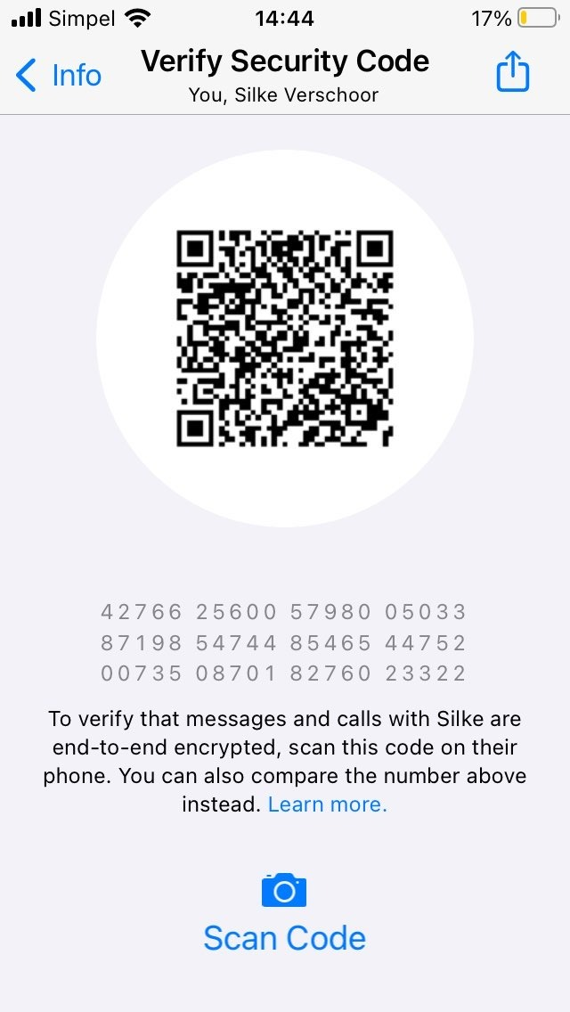
WhatsApp Security Code
Alice and Bob completed some key exchange with keys $(pk_{A}, pk_{B})$
They both compute the security code
$$H(pk_{A})∥H(pk_{B})$$
They compare their codes out of band
For example, by scanning the QR code while meeting in person
This eliminates the trusted third party (root CA), but this scales poorly
Notes:
Ordering matters: if $pk_{A}>pk_{B}$, then they compare $H\left(pk_{B}\right) || H(pk_{A})$ instead

Slide 48
Outline
Cryptography
Symmetric cryptography
Asymmetric cryptography
Protocols
Quantum threat
Problem
Solutions
Quantum key distribution
BB84
Information reconciliation
Privacy amplification
The authenticated channel
Comparing to non-quantum cryptography
Notes:
Goal is to get an overview of the various components of QKD, to understand the context in which QKD operates.
A non-goal is for the student to master all subjects in depth, after all this is a course on quantum communication, not on (quantum) cryptography.

Slide 49
Protocols
Protocols combine cryptographic primitives to achieve a security goal
AKE typically assumes that key authentication is solved separately.
Primitives alone do not prevent protocol-specific vulnerabilities such as replay attacks
Example: Authenticated Key Exchange (AKE)
Generate a fresh session key $k$ that is confidential and shared only between the (verified) owners of the public keys.

Slide 50
Transport Layer Security (TLS)
The s in https
TLS succeeded Secure Sockets Layer (SSL)
Client-Server protocol
Most of the internet: only the server authenticates (with a certificate)
If necessary, the client then authenticates to the server in-band (for example with a password)
Client authentication (with client certificates) is optional

Slide 51
TLS – security goals
Confidential and authenticated session key ($k_{1}$)
Server authentication
Client authentication (post-specified and optional)
Forward secrecy
compromise of any long-term secret ($sk_{S}$) does not compromise secrecy of earlier sessions
ephemeral keys are short-term secrets
aka “the key erasure” property:
we can delete traffic encryption keys when a session has completed, reducing the impact of a “hacked” machine
(Some) privacy
only random data is sent in plaintext
Privacy: confidentiality of metadata
Notes:
This definition of privacy is far from universal

Slide 52
TLS 1.3 (simplified)
$${\text{cert}}_{S}≈(S,pk_{S},σ_{\text{cert}}={\text{Sign}}_{sk_{CA}}(S, pk_{S}))$$
Client ($pk_{CA}$) |  | Server ($sk_{S}, pk_{S},{cert}_{S}$)
$$sk_{C},pk_{C}\underset{←}{\$}\text{Gen}\text{()} \\ r_{C}\underset{←}{\$}{\left\{0,1\right\}}^{256}$$ | $$pk_{C}, r_{C}$$
 | $$c,r_{S},{\text{cert}}_{S},σ_{S},t_{S}$$ | $$k_{0},c\underset{←}{\$}\text{Enc}(pk_{C}) \\ r_{S}\underset{←}{\$}{\left\{0,1\right\}}^{256} \\ σ_{S}←{\text{Sign}}_{sk_{S}}\left(pk_{C}, r_{C},c,r_{S},{\text{cert}}_{S}\right) \\ k_{1}←\text{Hash}(k_{0}, pk_{C}, r_{C},c,r_{S},{\text{cert}}_{S}) \\ t_{S}←{\text{MAC}}_{k_{1}}(pk_{C}, r_{C},c,r_{S},{\text{cert}}_{S},σ_{S})$$
$${\text{Verify}}_{pk_{CA}}\left(\left(S,pk_{S}\right), σ_{cert}\right) \\ {\text{Verify}}_{pk_{S}}\left(…, σ_{S}\right) \\ k_{0}←\text{Dec}(sk_{C}, c) \\ {\text{Verify}}_{k_{0}}\left(…, t_{S}\right) \\ k_{1}←\text{Hash}\left(…\right) \\ t_{C}←{\text{MAC}}_{k_{1}}\left(pk_{C},…,σ_{S},t_{S}\right)$$ | $$t_{C}$$
 |  | $${\text{Verify}}_{k_{1}}\left(…, t_{C}\right)$$
 | Traffic authenticate-encrypted with $k_{1}$
Notes:
No negotiation, no client certificates, no 0-RTT mode, no pre-shared keys, no KDFs/key-scheduling, no retry-requests, no message (de-)serialization, no splitting keys for multiple purposes, no backwards compatibility for dealing with middleboxes, no extensions, no record protocol, no alert protocol…

Slide 53
Other protocols
Signal/WhatsApp (X3DH)
Mutual authentication
Deniability
Handshake while peer is offline
Post-compromise security
Password based AKE (PAKE)
secure key from low-entropy password
Zero-knowledge proofs
Prove you know $x$ without revealing $x$
Secure Multiparty Computation (MPC)
computations with untrusted peers

Slide 54
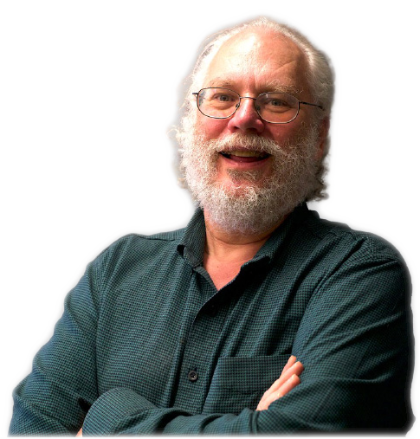
Security proofs
Cryptanalysis by protecting only against known attacks is insufficient
Security proofs for protocols are relative
if you can break this protocol, then you can break the underlying primitive
this is shown by a reduction (an algorithm converting one problem into another)
contrapositive $⇒$ if the primitive is secure, then the protocol is secure
Security proofs for cryptographic primitives are also relative
if you can break this primitive, then you can solve the underlying mathematical problem
we think the mathematics is hard because nobody has been able to solve it so far
¯\_(ツ)_/¯
computationally hard
Nobody?
Notes:
Many real-world protocols and primitives don’t even have security proofs, and the value of security proofs in general has seen much debate amongst cryptographers.

Slide 55
Outline
Cryptography
Symmetric cryptography
Asymmetric cryptography
Protocols
Quantum threat
Problem
Solutions
Quantum key distribution
BB84
Information reconciliation
Privacy amplification
The authenticated channel
Comparing to non-quantum cryptography
Notes:
Goal is to get an overview of the various components of QKD, to understand the context in which QKD operates.
A non-goal is for the student to master all subjects in depth, after all this is a course on quantum communication, not on (quantum) cryptography.

Slide 56
Quantum Algorithms
A quantum algorithm for computing a function $f$:
Prepare an $n$-qubit state $\left|ψ\right\rangle =\frac{1}{2^{n/2}}\sum_{k=0}^{2^{n}−1}{|k⟩}⊗|0⟩$
Apply $U_{f}$ (a unitary circuit implementing $f$) $U_{f}\left|ψ\right\rangle =\frac{1}{2^{n/2}}\sum_{k=0}^{2^{n}−1}{\left|k\right\rangle ⊗|f(k)⟩}$
You now have a superposition of $f$ on all possible inputs

Slide 57
Quantum Algorithms
Measure the output directly: collapse to $\left|k\right\rangle ⊗|f\left(k\right)⟩$ for some random $k$.
The real art of quantum algorithms is to manipulate the amplitudes
constructive interference on “desirable” states
destructive interference on “undesirable” states
This is not possible with classical states:
probabilities are positive real numbers
amplitudes are complex numbers

Slide 58
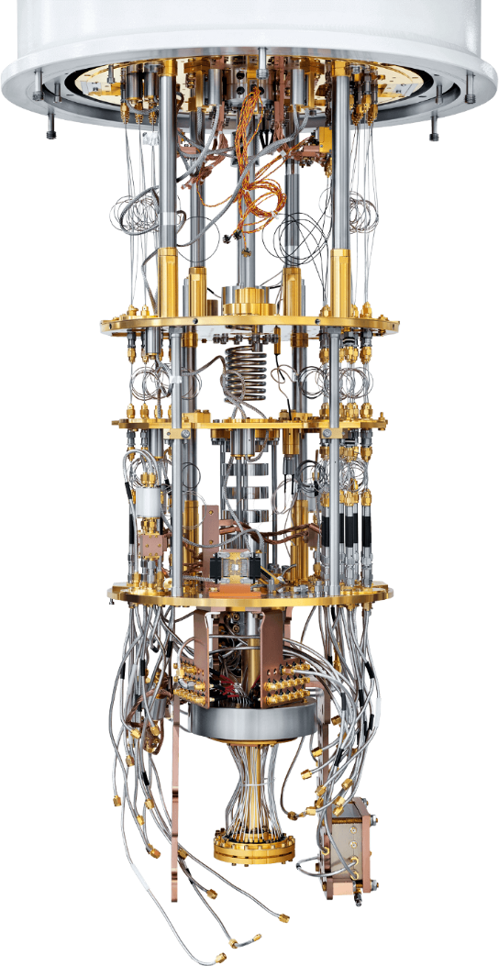
Quantum Computers
Two* algorithms threaten existing cryptography
Shor’s algorithm for period finding
Factoring ⇒ breaks RSA
find discrete logarithms ⇒ breaks ECC, breaks DH
Grover’s search algorithm
search a space of size $N$ with only $\sqrt{N}$ queries ⇒ try $2^{n}$ keys with only $2^{n/2}$ quantum queries ⇒ double key-length suffices for symmetric cryptography
hard to parallelize
speedup less in practice when comparing against supercomputers
Both require large-scale fault-tolerant quantum computers
these don’t exist (yet)
*) More algorithms exist, but their impact on widely deployed cryptography is roughly the same as Grover’s algorithm.

Slide 59
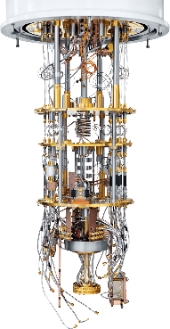
Store now, decrypt later
retrieve
store
time
today
2030? 2050? 2100?

Slide 60
Cryptographic goals
Mosca’s “theorem”
Estimate the following times
$x$: the time you need your data to be secure
$y$: the time to switch to quantum-safe cryptography
$z:$the time to develop a quantum computer
If $x+y>z$ you have a problem

Slide 61
Outline
Cryptography
Symmetric cryptography
Asymmetric cryptography
Protocols
Quantum threat
Problem
Solutions
Quantum key distribution
BB84
Information reconciliation
Privacy amplification
The authenticated channel
Comparing to non-quantum cryptography
Notes:
Goal is to get an overview of the various components of QKD, to understand the context in which QKD operates.
A non-goal is for the student to master all subjects in depth, after all this is a course on quantum communication, not on (quantum) cryptography.

Slide 62
Post-quantum cryptography
Post-quantum cryptography (PQC)
Requires: only classical computation/communication
Based on different mathematical problems
No known attack by quantum computers, but (most of) these systems are young
NIST prepares Module-Lattice Based KEM (ML-KEM) for standardization
Other agencies also recommend more conservative systems (such as McEliece)
NIST also prepares signatures:
Module-Lattice Based DSA (ML-DSA); and
Stateless Hash-Based DSA (SLH-DSA).
Kyber
Dilithium
SPHINCS+

Slide 63
PQC
Alice & Bob have classical computer
Eve has a quantum computer
Replace factoring (or discrete log) with other problems:
Lattice-based cryptography
both KEMs and signatures
Hash-based cryptography
signatures
Error correcting codes
KEMs
Multivariate cryptography
(mainly) signatures
Isogeny-based cryptography (mostly) broken
NIST
NIST

Slide 64
One-time signatures
We can use hash functions to build signatures
Revealing $k_{1−b}$ as well allows the adversary to forge arbitrary messages
$⇒$ we must never re-use the keypair
Example: One-time signature (OTS)
Private key: $$\left(k_{0},k_{1}\right)$$ Public key: $$\left(h_{0},h_{1}\right)=\left(H\left(k_{0}\right),H\left(k_{1}\right)\right)$$ Signature on bit $b$ is $k_{b}$ Verification checks that $H\left(b\right)=h_{b}$

Slide 65
Signatures
Example: Merkle signatures
Combine OTS public keys in a binary tree (called a Merkle tree): The public key is the tree root $h_{0}$ A signature is a one-time signature with part of the path, for example $$(k_{0}, h_{4},h_{2})$$

Slide 66
PQC
We are still relying on the assumed hardness of some mathematical problems.
QKD provides a cryptographic primitive that is independent of the computational resources of the adversary.
Thursday we’ll cover QKD, as originally introduced in
Charles H. Bennett and Gilles Brassard, 2014. Theoretical Computer Science, vol 560, part 1, pages 7-11. doi: 10.1016/j.tcs.2014.05.025

Slide 67
Outline
Cryptography
Symmetric cryptography
Asymmetric cryptography
Protocols
Quantum threat
Problem
Solutions
Quantum key distribution
BB84
Information reconciliation
Privacy amplification
The authenticated channel
Comparing to non-quantum cryptography
Notes:
Goal is to get an overview of the various components of QKD, to understand the context in which QKD operates.
A non-goal is for the student to master all subjects in depth, after all this is a course on quantum communication, not on (quantum) cryptography.

Slide 68
Quantum key distribution
Goal: Alice and Bob want to derive a fresh shared secret
Assuming:
They have a quantum channel
They have an authenticated classical channel
Use properties of quantum communication to
detect eavesdroppers
guarantee that no information leaked if no eavesdropper was present
Not assuming that Eve has limited computation power

Slide 69
QKD
Eve
+Authentication
+Verification
Notes:
“Note that eavesdropping on a quantum channel is generally impossible to do without altering the communication itself, so that is classified as an active attack.”
Normally in cryptography, we use Eve for the passive adversary that only eavesdrops on the communication. The active adversary is called Mallory, because she is malicious and tries to alter the outcome of a protocol. The QKD literature ignores this distinction and uses the name Eve for all kinds of attackers.

Slide 70
Security of QKD
Key is statistically independent from Eve’s observations
cannot be broken by trying more keys or future cryptanalysis
can be broken by exploiting discrepancies between hardware and model
Use key as one-time pad + statistical MAC:
security independent of any computational assumptions
Use key in computational (symmetric) cryptography
this is often necessary because of the low key-rate of QKD
breaks only if the computational cryptography breaks
PQC is relatively young, so there is less faith in its security

Slide 71
Security of QKD (cont.)
Everlasting security
if the protocol isn’t broken now (during execution), then the output key will never be broken later
protects against the adversary that becomes computationally unbounded in the future
or more realistically: protects in case the cryptography turns out to be insecure later
often (wrongly) called forward secrecy
Post-compromise security
after key-compromise, the protocol can become secure again
“the self-healing property”
assumes the adversary misses (at least one) opportunity for maintaining an active MitM attack
everlasting confidentiality

Slide 72
Security properties
(long-term) keys get compromised
No forward secrecy:
Forward secrecy:
Post-compromise security:
Everlasting security:
insecure
insecure
time
(long-term) keys get compromised
secure
insecure
time
key gets compromised
next key gets generated
insecure
secure
time
key gets generated (assuming generation was secure)
secure
time

Slide 73
QKD
“QKD provides unconditional security”
true in the narrow technical sense of the word
not conditioned on the computational resources available to the adversary
aka statistical security
aka information theoretical security (ITS)
security still conditional on other factors
secure environments (executing devices are not compromised)
hardware/software implementing QKD does not leak secret information
even when being probed by an adversary
requires statistically secure authentication
(more on that later)

Slide 74
Intermezzo
Short recap on quantum information
Notes:
Goal is to get an overview of the various components of QKD, to understand the context in which QKD operates.
A non-goal is for the student to master all subjects in depth, after all this is a course on quantum communication, not on (quantum) cryptography.

Slide 75
Qubit
In the computational basis
$$\left\{\left(\begin{matrix}1 \\ 0\end{matrix}\right),\left(\begin{matrix}0 \\ 1\end{matrix}\right)\right\}=\left\{\left|0\right\rangle , |1⟩\right\}$$
the state of a qubit is encoded as a vector
$$\left(\begin{matrix}α_{0} \\ α_{1}\end{matrix}\right)=α_{0}\left|0\right\rangle +α_{1}|1⟩$$
where the complex amplitudes $α_{0},α_{1}∈ℂ$ must be normalized
$${\left|α_{0}\right|}^{2}+{\left|α_{1}\right|}^{2}=1$$
The Bloch sphere visualizes a qubit $|ψ⟩$ (up to an irrelevant global phase):
$$\left|ψ\right\rangle =\cos{\frac{θ}{2}}\left|0\right\rangle +e^{iφ}\sin{\frac{θ}{2}}|1⟩$$
which I have animated online: https://www.geogebra.org/classic/ss7vbecx

Slide 76
Qubit visualized
$$\left|1\right\rangle$$
$$\left|1\right\rangle$$
$$\left|+\right\rangle$$
$$\left|0\right\rangle$$
computational basis ($+$)
$$\left|φ\right\rangle$$
$$\left|0\right\rangle$$
$$\left|+\right\rangle$$
Hadamard basis ($×$)
$$\left|−\right\rangle$$
$$\left|−\right\rangle$$
(The picture is incomplete: this only visualizes real amplitudes)

Slide 77
Measurement visualized
If we measure ( ) a qubit $|φ⟩$
it collapses onto the measurement basis
with probability defined by the in-product of qubit and basis vector
we get a classical bit ($x$) as output
$$\left|φ^{′}\right\rangle =\left|1\right\rangle$$
$$\left|1\right\rangle$$
$$\operatorname{Pr}\left[x=1\right]=\sin{{\left(π/4\right)}^{2}}{=0.5}$$
$$\left|φ\right\rangle =\left|+\right\rangle$$
$$\left|0\right\rangle$$
$$x=1$$
$$\left|0\right\rangle$$
$$\left|1\right\rangle$$
$$x=0$$
$$\left|φ^{′}\right\rangle =\left|0\right\rangle$$
$$\operatorname{Pr}\left[x=0\right]=\cos{{\left(π/4\right)}^{2}=0.5}$$
Notes:
*) a Von Neumann measurement is a special case of a projective measurement a projective measurement is a special case of a (quantum) measurement.

Slide 78
Measurement visualized
If we measure ( ) a qubit $|φ⟩$
it collapses onto the measurement basis
with probability defined by the in-product of qubit and basis vector
we get a classical bit ($x$) as output
$$\left|+\right\rangle$$
$$\left|φ\right\rangle =\left|+\right\rangle$$
$$\operatorname{Pr}\left[x=1\right]=0$$
$$x=1$$
$$\left|φ^{′}\right\rangle =\left|−\right\rangle$$
$$x=0$$
$$\left|φ^{′}\right\rangle =\left|+\right\rangle$$
$$\left|−\right\rangle$$
$$\operatorname{Pr}\left[x=0\right]=1$$
$$\left|−\right\rangle$$
Notes:
*) a Von Neumann measurement is a special case of a projective measurement a projective measurement is a special case of a (quantum) measurement.

Slide 79
Von Neumann measurement
More general measurements exist, but we don’t need them today.
Definition: von Neumann measurement
A von Neumann measurement with respect to orthonormal basis $\left\{\left|φ_{i}\right\rangle \right\}$ on state $$\left|ψ\right\rangle =\sum_{i}{α_{i}}|φ_{i}⟩$$ gives output $i$; and leaves the system in state $|φ_{i}⟩$ with probability ${\left|α_{i}\right|}^{2}$

Slide 80
Outline
Cryptography
Symmetric cryptography
Asymmetric cryptography
Protocols
Quantum threat
Problem
Solutions
Quantum key distribution
BB84
Information reconciliation
Privacy amplification
The authenticated channel
Comparing to non-quantum cryptography
Notes:
Goal is to get an overview of the various components of QKD, to understand the context in which QKD operates.
A non-goal is for the student to master all subjects in depth, after all this is a course on quantum communication, not on (quantum) cryptography.

Slide 81
Bennett-Brassard 1984 (BB84)
Continued the unpublished work of Wiesner from 1983 on quantum money
First description of QKD

Slide 82
Bennett-Brassard (BB84)
1. | $$|+⟩$$ | $$|1⟩$$ | $$|−⟩$$ | $$|0⟩$$ | $$|1⟩$$ | $$|1⟩$$ | $$|0⟩$$ | $$|0⟩$$ | $$|−⟩$$ | $$|+⟩$$ | $$|1⟩$$ | $$|−⟩$$ | $$|+⟩$$ | $$|+⟩$$ | $$|1⟩$$
2. | $$+$$ |  | $$×$$ |  | $$+$$ | $$×$$ | $$×$$ | $$+$$ |  | $$+$$ | $$×$$ | $$×$$ |  | $$×$$ | $$+$$ | 2
3. |  |  | ✓ |  | ✓ |  |  | ✓ |  |  |  | ✓ |  | ✓ |  | 3
4. |  |  |  |  | 1 |  |  |  |  |  |  |  |  | 0 |  | 4
5. |  |  |  |  | ✓ |  |  |  |  |  |  |  |  | ✓ |  | 5
6. |  |  | 1 |  |  |  |  | 0 |  |  |  | 1 |  |  | 1
1. | $$|+⟩$$ | $$|1⟩$$ | $$|−⟩$$ | $$|0⟩$$ | $$|1⟩$$ | $$|1⟩$$ | $$|0⟩$$ | $$|0⟩$$ | $$|−⟩$$ | $$|+⟩$$ | $$|1⟩$$ | $$|−⟩$$ | $$|+⟩$$ | $$|+⟩$$ | $$|1⟩$$
2. | $$+$$ |  | $$×$$ |  | $$+$$ | $$×$$ | $$×$$ | $$+$$ |  | $$+$$ | $$×$$ | $$×$$ |  | $$×$$ | $$+$$ | 2
3. |  |  | ✓ |  | ✓ |  |  | ✓ |  |  |  | ✓ |  | ✓ |  | 3
4. |  |  |  |  | 1 |  |  |  |  |  |  |  |  | 0 |  | 4
5. |  |  |  |  | ✓ |  |  |  |  |  |  |  |  | ✓ |  | 5
6. |  |  | 1 |  |  |  |  | 0 |  |  |  | 1 |  |  | 1
1. | $$|+⟩$$ | $$|1⟩$$ | $$|−⟩$$ | $$|0⟩$$ | $$|1⟩$$ | $$|1⟩$$ | $$|0⟩$$ | $$|0⟩$$ | $$|−⟩$$ | $$|+⟩$$ | $$|1⟩$$ | $$|−⟩$$ | $$|+⟩$$ | $$|+⟩$$ | $$|1⟩$$
2. | $$+$$ |  | $$×$$ |  | $$+$$ | $$×$$ | $$×$$ | $$+$$ |  | $$+$$ | $$×$$ | $$×$$ |  | $$×$$ | $$+$$ | 2
3. |  |  | ✓ |  | ✓ |  |  | ✓ |  |  |  | ✓ |  | ✓ |  | 3
4. |  |  |  |  | 1 |  |  |  |  |  |  |  |  | 0 |  | 4
5. |  |  |  |  | ✓ |  |  |  |  |  |  |  |  | ✓ |  | 5
6. |  |  | 1 |  |  |  |  | 0 |  |  |  | 1 |  |  | 1
1. | $$|+⟩$$ | $$|1⟩$$ | $$|−⟩$$ | $$|0⟩$$ | $$|1⟩$$ | $$|1⟩$$ | $$|0⟩$$ | $$|0⟩$$ | $$|−⟩$$ | $$|+⟩$$ | $$|1⟩$$ | $$|−⟩$$ | $$|+⟩$$ | $$|+⟩$$ | $$|1⟩$$
2. | $$+$$ |  | $$×$$ |  | $$+$$ | $$×$$ | $$×$$ | $$+$$ |  | $$+$$ | $$×$$ | $$×$$ |  | $$×$$ | $$+$$ | 2
3. |  |  | ✓ |  | ✓ |  |  | ✓ |  |  |  | ✓ |  | ✓ |  | 3
4. |  |  |  |  | 1 |  |  |  |  |  |  |  |  | 0 |  | 4
5. |  |  |  |  | ✓ |  |  |  |  |  |  |  |  | ✓ |  | 5
6. |  |  | 1 |  |  |  |  | 0 |  |  |  | 1 |  |  | 1
1. | $$|+⟩$$ | $$|1⟩$$ | $$|−⟩$$ | $$|0⟩$$ | $$|1⟩$$ | $$|1⟩$$ | $$|0⟩$$ | $$|0⟩$$ | $$|−⟩$$ | $$|+⟩$$ | $$|1⟩$$ | $$|−⟩$$ | $$|+⟩$$ | $$|+⟩$$ | $$|1⟩$$
2. | $$+$$ |  | $$×$$ |  | $$+$$ | $$×$$ | $$×$$ | $$+$$ |  | $$+$$ | $$×$$ | $$×$$ |  | $$×$$ | $$+$$ | 2
3. |  |  | ✓ |  | ✓ |  |  | ✓ |  |  |  | ✓ |  | ✓ |  | 3
4. |  |  |  |  | 1 |  |  |  |  |  |  |  |  | 0 |  | 4
5. |  |  |  |  | ✓ |  |  |  |  |  |  |  |  | ✓ |  | 5
6. |  |  | 1 |  |  |  |  | 0 |  |  |  | 1 |  |  | 1
1. | $$|+⟩$$ | $$|1⟩$$ | $$|−⟩$$ | $$|0⟩$$ | $$|1⟩$$ | $$|1⟩$$ | $$|0⟩$$ | $$|0⟩$$ | $$|−⟩$$ | $$|+⟩$$ | $$|1⟩$$ | $$|−⟩$$ | $$|+⟩$$ | $$|+⟩$$ | $$|1⟩$$
2. | $$+$$ |  | $$×$$ |  | $$+$$ | $$×$$ | $$×$$ | $$+$$ |  | $$+$$ | $$×$$ | $$×$$ |  | $$×$$ | $$+$$ | 2
3. |  |  | ✓ |  | ✓ |  |  | ✓ |  |  |  | ✓ |  | ✓ | ✓ | 3
4. |  |  |  |  | 1 |  |  |  |  |  |  |  |  | 0 |  | 4
5. |  |  |  |  | ✓ |  |  |  |  |  |  |  |  | ✓ |  | 5
6. |  |  | 1 |  |  |  |  | 0 |  |  |  | 1 |  |  | 1
Alice sends random qubits (some may not arrive)
Bob measures in random bases, reveals them to Alice after the measurement
Alice confirms when sending/measurement basis were the same
Bob reveals each measurement outcome bit with probability ½
Alice confirms if the bits are correct (and aborts if any bit is incorrect)
Both use the remaining bits as shared key: 1011
All classical messages are authenticated, as indicated by the tags ( ).

Slide 83
A note on notation
I write $+$ for the computational/rectlinear basis and $×$ for the Hadamard/diagonal basis, which corresponds to the polarization direction of the qubit encoded as a photon.
I also write $|+⟩$ for the plus-state and $\left|−\right\rangle$ for the minus-state, which correspond to the diagonally polarized photon ⤢ and the anti-diagonally polarized photon ⤡.
The difference is indicated by the ket-notation:
$+ =\left\{\left|0\right\rangle ,|1⟩\right\}$ is a basis
$\left|+\right\rangle =\left(\left|0\right\rangle +|1⟩\right)/\sqrt{2}$ is a qubit state
Apologies if this is confusing

Slide 84
BB84: random number generator
For randomness ($\underset{←}{\$})$ , we require a true random number generator (TRNG)
$b\underset{←}{\$}\left\{0,1\right\}$
for every bit $b$ (independently): $\operatorname{Pr}\left[b=0\right]=\operatorname{Pr}\left[b=1\right]=\frac{1}{2}$
often implemented as a quantum RNG (QRNG)
conceptually simple: measure $|+⟩$ in the computational basis
practically difficult: debiasing hardware imperfections, etc.
Notes:
Sometimes $Pr\left[b=0\right]=\frac{1}{2}±ε$ where $ε$ is negligibly small suffices.

Slide 85
BB84: qubit transmission
Alice:
generates random bit $a_{i}\underset{←}{\$}\{0,1\}$
generates random encoding basis $α_{i}\underset{←}{\$}\left\{+,×\right\}$
creates qubit $\left|φ_{i}\right\rangle =\left\{\begin{aligned}\left|0\right\rangle \text{if} a_{i}=0∧α_{i}=+ \\ \left|1\right\rangle \text{if} a_{i}=1∧α_{i}=+ \\ \left|+\right\rangle \text{if} a_{i}=0∧α_{i}= × \\ \left|−\right\rangle \text{if} a_{i}=1∧α_{i}= ×\end{aligned}\right.$
sends $|φ_{i}⟩$ to Bob
Bob:
generates random measurement basis $β_{i}\underset{←}{\$}\left\{+,×\right\}$
receives $\left|φ_{i}^{′}\right\rangle$ from Alice
measures $|φ_{i}^{′}⟩$ in basis $β_{i}$ with outcome bit $b_{i}$

Slide 86
BB84: sifting
Bob sends his bases $β_{1}, β_{2},…, β_{n}$ to Alice
Alice replies with her bases $α_{1},α_{2},…,α_{n}$
Alice and Bob discard all symbols where $α_{i}≠β_{i}$
Some notation:
write $S=\{i|α_{i}=β_{i}\}$ for the indices of sifted (non-discarded) bits
write $a_{S}$ for Alice’s sifted bits
write $b_{S}$ for Bob’s sifted bits
Bob must send his bases first!

Slide 87
(Plain) BB84: error detection
Per sifted bit, Bob reveals $b_{i}$ with probability ½ (by sending it to Alice)
Alice checks that $a_{i}=b_{i}$ for all revealed bits
If any bit is wrong, Alice aborts
Alice confirms to Bob (she sends “OK”)
Alice outputs the sifted, non-revealed bits $a_{i}$
On Alice’s confirmation, Bob outputs the sifted, non-revealed bits $b_{i}$

Slide 88
BB84
Plain BB84:
Qubit transmission
Sifting
Error detection
Secure BB84:
Qubit transmission
Sifting
QBER estimation
Error correction
Privacy amplification
Notes:
Plain BB84 is not just less efficient when we introduce noise on the channel, it really is insecure. An attacker that eavesdrops on only a few qubit transmissions succeeds in the attack with unacceptably high probability, even if it just reveals some key bits.

Slide 89
BB84, improvements
Information reconciliation
error correction instead of error detection
Privacy amplification
Eve may have some information about the secret bits
“distill” these bits a shorter key so Eve has only negligible information

Slide 90
Quantum bit error rate
Definition: quantum bit error rate (QBER)
The quantum bit error rate is the probability $$\operatorname{Pr}{[a_{i}≠b_{i}]}$$ where $i∈S$ (we only consider sifted bits)
The real QBER is unknown, but we can estimate it
reveal some bits (statistically estimate the real QBER from that of the revealed sample)
we must discard those revealed bits
assume some constant QBER
use the QBER of the previous block
estimate using other info from the channel
can Eve affect this? (does it matter?)

Slide 91
Outline
Cryptography
Symmetric cryptography
Asymmetric cryptography
Protocols
Quantum threat
Problem
Solutions
Quantum key distribution
BB84
Information reconciliation
Privacy amplification
The authenticated channel
Comparing to non-quantum cryptography
Notes:
Goal is to get an overview of the various components of QKD, to understand the context in which QKD operates.
A non-goal is for the student to master all subjects in depth, after all this is a course on quantum communication, not on (quantum) cryptography.

Slide 92
Error correction
Forward error correction (FEC)
add redundancy to a message to protect against transmission errors
Hamming distance (HD) is 3 $⇒$ we can correct $\left\lfloor 3/2\right\rfloor =1$ errors
(HD: number of differing bits)
An encoded message is called a (valid) codeword
Example: (3-1) repetition code
Encoding: repeat each data bit three times encode 0 as 000 encode 1 as 111 Decoding: select the output bit by “majority vote” decode 010 as 0 decode 110 as 1

Slide 93
Error correction – parity check codes
Definition: parity-check codes
Given the parity-check matrix $H∈{\left\{0,1\right\}}^{m×n}$, valid codewords $c$ satisfy $$Hc^{T}=0$$
Example: parity-check code
$$Hc^{T}=\left[\begin{matrix}1 & 1 & 0 & 1 & 0 & 0 \\ 0 & 1 & 1 & 0 & 1 & 0 \\ 1 & 1 & 1 & 0 & 0 & 1\end{matrix}\right]\left[\begin{matrix}1 \\ 1 \\ 0 \\ 0 \\ 1 \\ 0\end{matrix}\right]=\left[\begin{matrix}0 \\ 0 \\ 0\end{matrix}\right]$$ so ${110010}_{2}$ is a valid codeword
$x_{2}$ indicates that $x$ is written in base 2

Slide 94
Error correction – parity check codes
Assume we receive $y={101010}_{2}$
$$Hy^{T}=\left[\begin{matrix}1 & 1 & 0 & 1 & 0 & 0 \\ 0 & 1 & 1 & 0 & 1 & 0 \\ 1 & 1 & 1 & 0 & 0 & 1\end{matrix}\right]\left[\begin{matrix}1 \\ 0 \\ 1 \\ 0 \\ 1 \\ 0\end{matrix}\right]=\left[\begin{matrix}1 \\ 0 \\ 0\end{matrix}\right]$$
Since we got syndrome $s={100}_{2}≠0$ there must have been an error
the first parity check equation failed $⇒$ bit 1, 2, or 4 must have flipped
flipping bit 4 corrects this $⇒$ codeword was $c={101110}_{2}$
this code has $\text{HD}=3$ between codewords, so $c$ is correct
assuming only one bitflip occurred
Maximum likelihood (ML) decoding: choose amongst all possible codewords

Slide 95
Error correction – parity check codes
Encode a message $u$ using generator matrix $G∈{\left\{0,1\right\}}^{k×n}$
$$c=uG$$
For example, encoding $u={011}_{2}$
$$c=\left[\begin{matrix}0 & 1 & 1\end{matrix}\right]\left[\begin{matrix}1 & 0 & 0 & 1 & 0 & 1 \\ 0 & 1 & 0 & 1 & 1 & 1 \\ 0 & 0 & 1 & 0 & 1 & 1\end{matrix}\right]=\left[\begin{matrix}0 & 1 & 1 & 1 & 0 & 0\end{matrix}\right]$$
To find $G$:
write $H=\left[A | I_{n−k}\right]$ (called the systematic form of $H$)
then $G=\left[I_{k} | A^{T}\right]$
In systematic form, the message is the prefix of the codeword

Slide 96
LDPC codes
Low-density parity-check (LDPC) codes
Low density (very few non-zero entries in $H$)
Allows noise close to the theoretical Shannon limit
Has seen much study and usage
Various methods exist for generating $H$
Allows for efficient decoders, using properties of the generation method

Slide 97
Information reconciliation
The same redundancy that allows FEC also leaks information in QKD
We must assume that all errors are because of Eve
We send the redundant information after sifting
fewer corrections required
we only correct sifted bits
redundant information is classical, transmission can be made virtually error-free
but the redundant information completely leaks to the adversary
For every parity check equation, you leak (at most) one bit
After IR with $k×n$ code, we need to discard at least $n−k$ bits

Slide 98
Information reconciliation
Continuous variable QKD (CV-QKD) has a much signal-to-noise ratio (SNR)
Difficult for IR to keep up with the system clock rate
Often uses reverse reconciliation (RR)
Bob transmits the error correction information to Alice
Possible to correct errors on the signal instead of the bits(?)

Slide 99
Outline
Cryptography
Symmetric cryptography
Asymmetric cryptography
Protocols
Quantum threat
Problem
Solutions
Quantum key distribution
BB84
Information reconciliation
Privacy amplification
The authenticated channel
Comparing to non-quantum cryptography
Notes:
Goal is to get an overview of the various components of QKD, to understand the context in which QKD operates.
A non-goal is for the student to master all subjects in depth, after all this is a course on quantum communication, not on (quantum) cryptography.

Slide 100
Privacy amplification
After reconciliation, Alice and Bob share a value $x$
Some information on $x$ may have leaked to Eve
For example, if they eavesdropped on only some qubit transmission
Alice and Bob want to compute a function $g_{y}(x)$ so that Eve has at most negligible information on $g_{y}\left(x\right)$
$y$ can be transmitted over the authenticated channel (and leak to Eve)
$\left|g_{y}\left(x\right)\right|<\left|x\right|$ (we lose some bits)

Slide 101
Privacy amplification
Eve has some knowledge on $x$, expressed as $e(x)$ for some $e:{\left\{0,1\right\}}^{N}→{\left\{0,1\right\}}^{K}$
Eve knows a subset of possible candidates for $x$: $$E=\left\{z∈{\left\{0,1\right\}}^{N} \right| e\left(z\right)=e\left(x\right)\}$$
Let $𝒢$ be the set of all functions from ${\left\{0,1\right\}}^{N}$ to ${\left\{0,1\right\}}^{R}$, Alice samples $$g_{y}\underset{←}{\$}𝒢$$ so that knowledge of $E$ and $g_{y}$ yields an expected $\log{(1+2^{R}/\left|E\right|)}$ bits of information about $g_{y}(x)$
Problem: this scheme requires $R2^{N}$ bits to send $y$ to Bob
Solution: let $𝒢$be a universal hash family

Slide 102
Outline
Cryptography
Symmetric cryptography
Asymmetric cryptography
Protocols
Quantum threat
Problem
Solutions
Quantum key distribution
BB84
Information reconciliation
Privacy amplification
The authenticated channel
Comparing to non-quantum cryptography
Notes:
Goal is to get an overview of the various components of QKD, to understand the context in which QKD operates.
A non-goal is for the student to master all subjects in depth, after all this is a course on quantum communication, not on (quantum) cryptography.

Slide 103
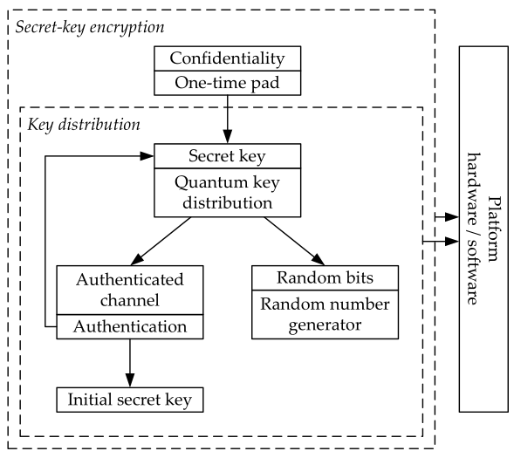
QKD
+ authentication + ITS MAC
source: van Assche

Slide 104
Authenticated channels
Authenticated channels do not exist in a meaningful way, instead we authenticate messages on a public channel
Protocol should ensure some protection against replay/reordering attacks
Statistically secure message authentication
Can be achieved with Wegman-Carter MACs
Assumes a pre-shared key
Classically, getting a shared key is entire purpose of key distribution
Cryptographers say that QKD does key expansion
(Part of) the key must be discarded after use
protection against key exhaustion is required
Notes:
Key exhaustion is a known problem with little attention in the literature. The original BB84 paper states:
“Key bits are gradually used up in the Wegman-Carter scheme, and cannot be reused without compromising the system’s provable security; however […] these key bits can be replaced by fresh random bits successfully transmitted through the quantum channel.”

Slide 105
Authenticated channels (cont.)
Optionally, we use computationally secure authentication (signatures)
improves scalability
insecure against active attackers with sufficient computing power
we still get everlasting security
but no ITS
but can be used for bootstrapping:
secure the first round of QKD with signatures
use (part of) the QKD output as MAC keys in subsequent rounds
The authentication requirement impacts the scalability of QKD
public key authentication provides scalability, at the cost of reduced security
pre-shared keys provide statistical security, at the cost of scalability

Slide 106
Outline
Cryptography
Symmetric cryptography
Asymmetric cryptography
Protocols
Quantum threat
Problem
Solutions
Quantum key distribution
BB84
Information reconciliation
Privacy amplification
The authenticated channel
Comparing to non-quantum cryptography
Notes:
Goal is to get an overview of the various components of QKD, to understand the context in which QKD operates.
A non-goal is for the student to master all subjects in depth, after all this is a course on quantum communication, not on (quantum) cryptography.

Slide 107
One more limitation of QKD
Quantum channels have a limited distance
Solution:
Trusted intermediate nodes can “relay” keys
You lose end-to-end security (E2E): a compromised intermediate compromises
Quantum repeaters can extend a quantum channel
Use entanglement and quantum teleportation
Requires hardware that does not exist (yet)
You’ll learn more about this later in the course

Slide 108
QKD versus PQC
QKD | PQC
☺ Statistically secure | ☹ Computationally secure
☹ Hardware + software upgrade | ☺ Software upgrade
☹ Symmetric | ☺ Asymmetric
☹ One-time use keys | ☺ Re-use keys
☹ No E2E | ☺ E2E (computational)
☹ Quantum + classical side-channels | ☺ Classical side-channels

Slide 109
QKD with PQC
Signature authentication of QKD itself Key combined with an end-to-end PQC AKE
QKD + PQC | PQC
☺ Everlasting security | ☹ Computationally secure
☹ Hardware + software upgrade | ☺ Software upgrade
☺ Asymmetric | ☺ Asymmetric
☹ One-time use keys | ☺ Re-use keys
☹ E2E (computational) | ☺ E2E (computational)
☹ Quantum + classical side-channels | ☺ Classical side-channels

Slide 110
QKD with PQC and quantum repeaters
QKD + PQC | PQC
☺ Everlasting security | ☹ Computationally secure
☹ Hardware + software upgrade | ☺ Software upgrade
☺ Asymmetric | ☺ Asymmetric
☹ One-time use keys | ☺ Re-use keys
☺ E2E (statistical) | ☹ E2E (computational)
☹ Quantum + classical side-channels | ☺ Classical side-channels

Slide 111
QKD – key usage
Shared symmetric keys can be used for many cryptographic applications
OTP + ITS MAC: statistically secure authenticated encryption
Most deployed systems see QKD keys used for computational encryption (AES)
data is no longer statistically secure
more efficient (QKD key rates are relatively low)
in most scenarios, using only AES we can do virtually the same

Slide 112
QKD+AES vs AES
QKD + AES encryption:
Expand a key with QKD
Encrypt data with AES
No everlasting security
Forward secure
Post-compromise secure
Breaks if AES or QKD is broken
Practical(?)
AES:
Expand a key with AES
Encrypt data with AES
No everlasting security
Forward secure
Not post-compromise secure
Breaks if AES is broken
Practical

Slide 113
Goals for this module
How does cryptography used today work?
How do quantum computers pose a threat to (online) security?
How can quantum communication provide security?
Notes:
Content: security protocols, symmetric and asymmetric encryption, quantum threat and consequences, classic and quantum cyber-attacks, post-quantum cryptography, key exchange protocols (classic and QKD based), man-in-the-middle, BB84, key distillation, QBER

Slide 114
References
G. Cariolaro, Quantum Communications. Springer International Publishing, 2015.
G. Brassard and C. H. Bennett, Quantum cryptography: Public key distribution and coin tossing. Theoretical Computer Science, vol. 560, pp. 7-11, 2014. (https://doi.org/10.1016/j.tcs.2014.05.025)
G. van Assche, Quantum Cryptography and Secret-Key Distillation. Cambridge: Cambridge University Press, 2006. (https://doi.org/10.1017/CBO9780511617744)
M. A. Nielsen and I. L. Chuang, Quantum computation and quantum information, 10th anniversary ed., Cambridge: Cambridge University Press, 2010.
The Transport Layer Security (TLS) Protocol Version 1.3, August 2018. (https://www.rfc-editor.org/info/rfc8446)
C. H. Bennett, G. Brassard, and J-M. Robert, Privacy amplification by public discussion. SIAM J. Computing, Vol 17, No 2, 1988. (https://doi.org/10.1137/0217014)

